Slide 1
Project Name: Pizza Sales Insight
Objective: Analyze pizza sales to identify best-selling items, peak sales hours,
and customer preferences, ultimately aiding in better business decisions.
Data Sources: -1) Orders Table:- Details of each order.
2) Orders Details Table:- Quantity and order specifics.
3)Pizzas Table:- Pizza prices.
4)Pizza Type Table:- Categorization of pizzas by type

Slide 2
Project Name: Pizza Sales Insight
Key Analyses
2. Best-Selling Pizzas:-Ranked pizzas by sales.
3. Cumulative Revenue:- Tracked revenue growth over time.
4. Pizza Type Analysis:-Examined sales trends by pizza type.
1.Sales Per Hour:- Identified peak sales hours.

Slide 3
Project Name: Pizza Sales Insight
Tools and Techniques:
SQL: Used for data extraction and analysis.
Key SQL Functions JOINs, aggregate functions, window functions, and subqueries.

Slide 4
SUMARRY
The "Pizza Sales Insight" project reveals critical insights into pizza sales, including identifying top-selling pizzas, peak sales hours, and preferences for different pizza types. These findings provide a clear direction for optimizing inventory, targeting promotions, and enhancing overall sales strategies.

Slide 5
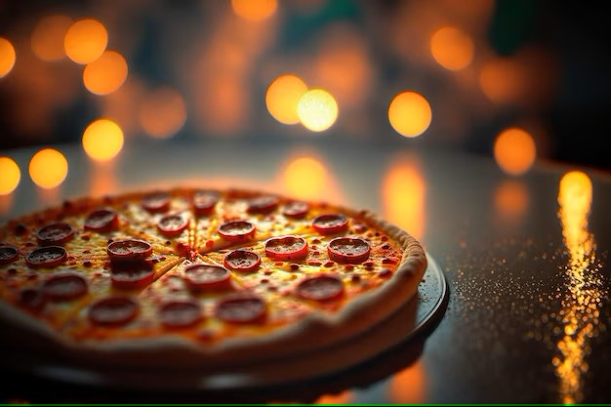
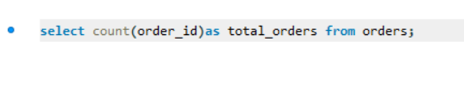
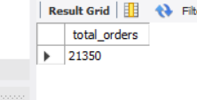
Q 1 :- Retrieve the total number of orders place

Slide 6
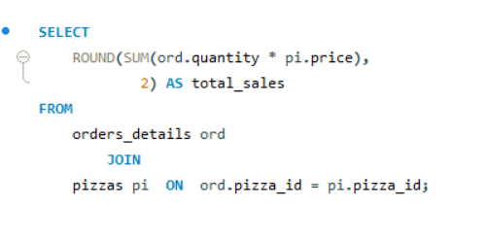
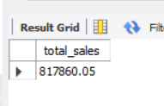
Q 2 :CALCULATE THE TOTAL REVENUE GENRTAED FROM PIZZA SALES

Slide 7
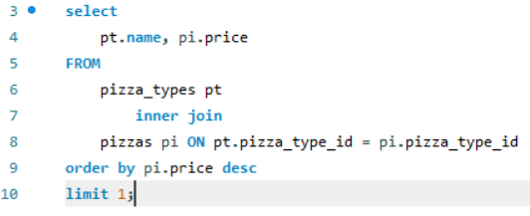
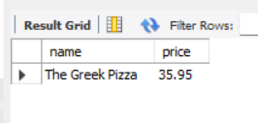
Q 3: IDENTIFY THE HIGHEST PRICED PIZZA

Slide 8
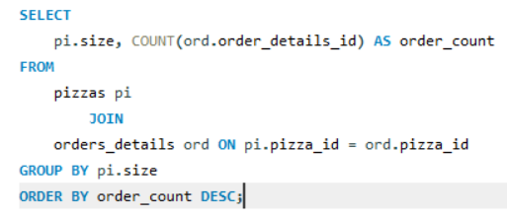
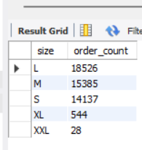
Q 4: IDENTIFY THE M0ST COMMON PIZZA SIZE ORDERD

Slide 9
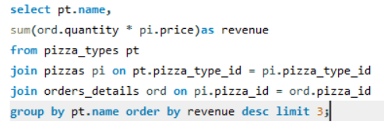
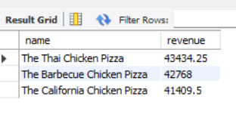
Q 5: DETERMINE THE TOP 3 MOST ORDERED PIZZA TYPES BASED ON REVENUE

Slide 10
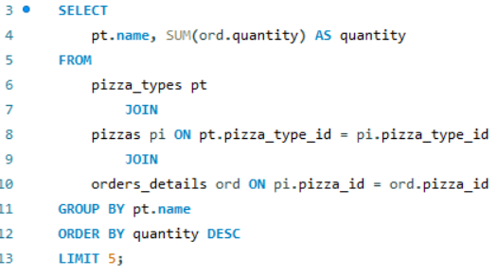
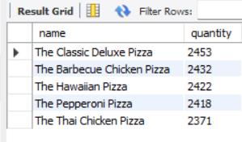
Q 6: LIST THE TOP 5 MOST ORDERD PIZZA TYPES ALONG WITH THEIR QUANTITIES

Slide 11
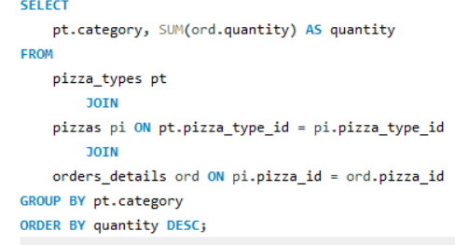
Q 7: JOIN THE NECESSARY TABLES TO IFND THE TOTAL QUANTITY OF EACH PIZZAS CATEGORY ORDERED

Slide 12
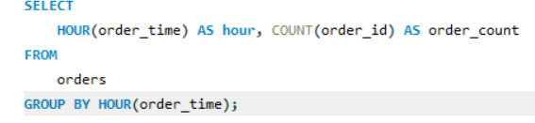
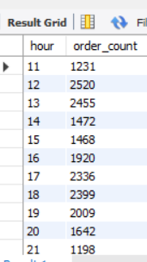
Q 8: DETRMINE THE DISTRIBUTION OF ORDERS BY HOUR OF THE DAY

Slide 13

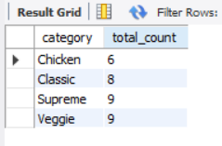
Q 9: CATEGORY-WISE DISTRIBUTION OF PIZZAS

Slide 14
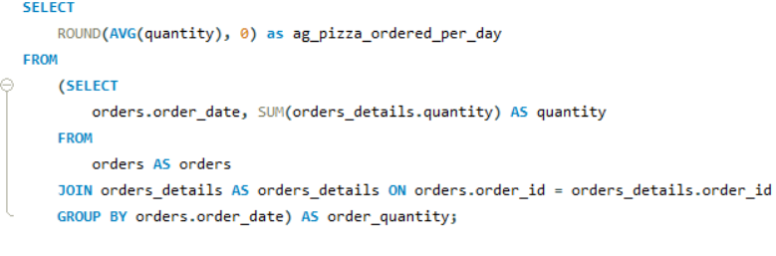
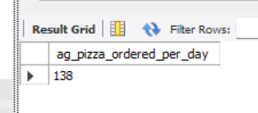
Q 10 . GROUP THE ORDERS BY THE AND CALCULATE THE AVERAGE NUMBER OF PIZZAS ORDERED PER DAY

Slide 15
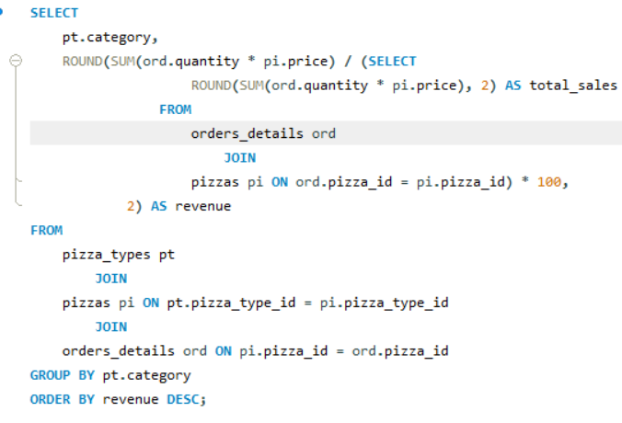
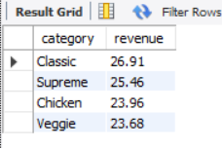
Q 11: CALCULATE THE PERCENTAGE CONTRIBUTION OF EACH PIZZA TYPE TO TOTAP REVENUE

Slide 16
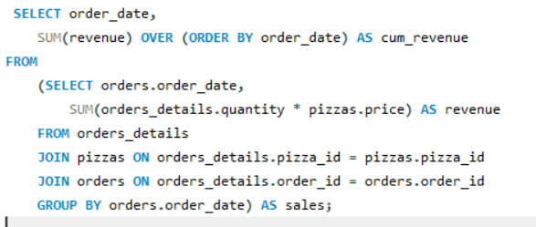
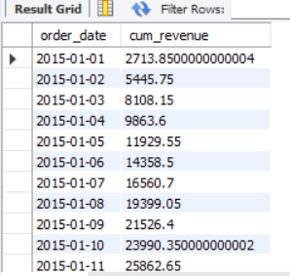
Q 12: ANALYZE THE CUMULATIVE REVENUE GENERTAED OVER TIME

Slide 17
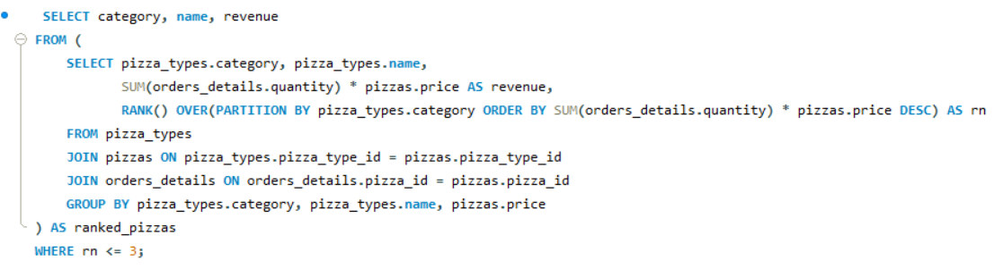
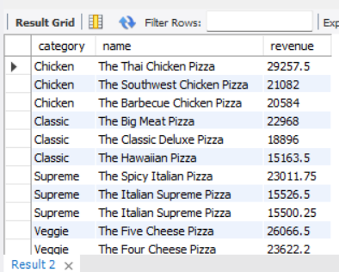
Q 13: DETEMINE THE TOP 3 MOST ORDERED PIZZA TYPE BASED ON REVENUE FOR EACH PIZZA CATEGORY

Slide 18


